Slide 1

Calling all Techies & Non-Techies...
Start to Finish in One Year:
Virtual One Stop Student Service Center
Juliette Punchello, MS, MA
Thomas Edison State College, NJ
jpunchello@tesc.edu
609-984-7188 X 3475

Slide 2
Why Virtual?
Value to client/student
Serves diverse population
Removes barriers to time/space
Presents consistent information
On-line student services delivery mirrors on-line courseware

Slide 3
How Virtual?
Online Student Services
Online Course Delivery
Student Centered Portal
Extended Hours for Phone Interactions
Enhanced Student Services Website
Track Results through Online Survey
Notes:
We have adults from all walks of life coming to Thomas Edison State College. We have corporate managers coming back to get their Bachelor or Masters Degrees. We have military personnel, as well as the community college students attending. There are the people who are in job transitions, and the adult that just want to try it for because it gives them self-satisfaction.
Thomas Edison State College had it largest freshman class in school history.

Slide 4
When Virtual?
Student Portal available 24/7 year round
Self-Service structure empowers students to:
  Schedule advising appointment
  Build community
  Schedule test dates
  View Evaluation
  Register for Courses
  Chat with other students
  Order textbooks
  Visit Library

Slide 5
Easy as 1, 2, 3
Approval and Buy In from Key Constituencies
Dedicated leader with accountability checks
Vision of entire project (start to finish)

Slide 6
Easy as A, B, C
Support and Resources to drive project to completion
Student Needs Analysis
Content based on proactively responding to student needs
Language, colors, photos reflect community of student
Focus groups for input (partners, staff and students)

Slide 7
Easy as Pie!
Survey of effectiveness (results tracked monthly)
Update as needed based on Analytics reports
Publicize new site (e-mails, web blast, partner site)

Slide 8
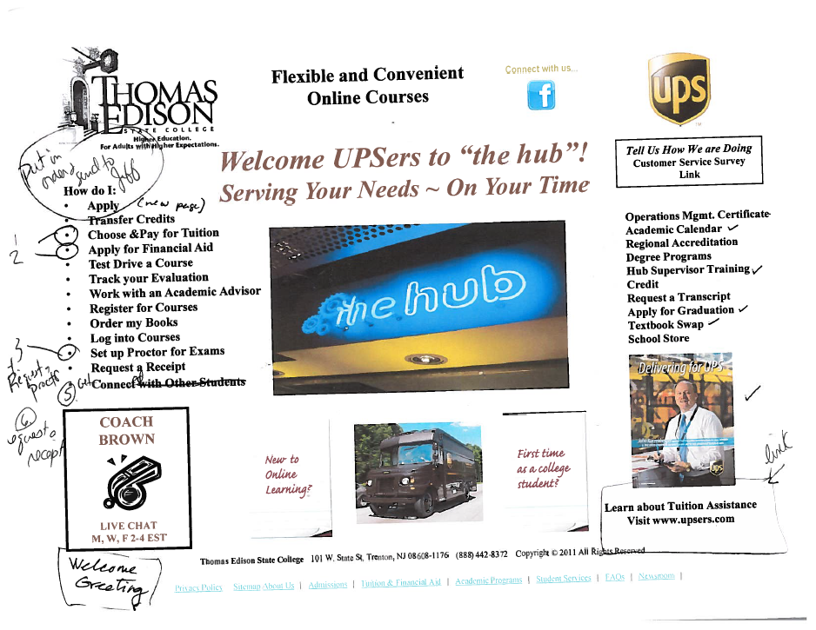
Virtual Sample #1
Notes:
Transfer Courses
Maximum of 80 credits from a Community College
Maximum of 90 credits from a Foreign Country Institution
No overall resident require
TESC COURSES
12 WK ON-LINE COURSES, 16 WK GUIDED STUDY COURSES
MID-TERMS AND FINALS (DESIGNATED LOCATIONS/PROCTORED)
LICENCE AND CERTIFICATES (SEE PAGE 104 & 105 Catalog)
Notarized copy
ACE Credit
An ACE Registry Required (202) 939-9434

Slide 9
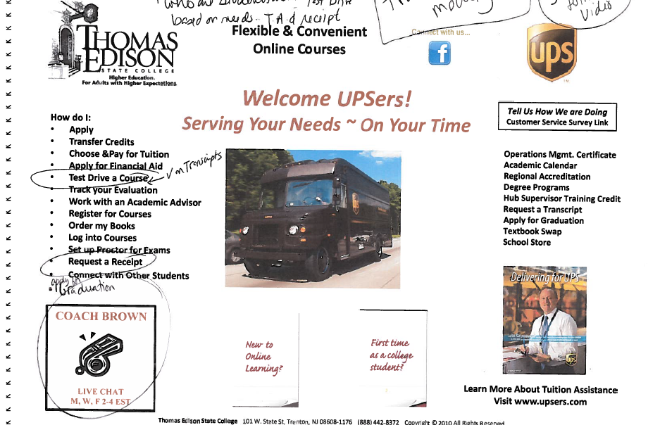
Virtual Sample #2

Slide 10
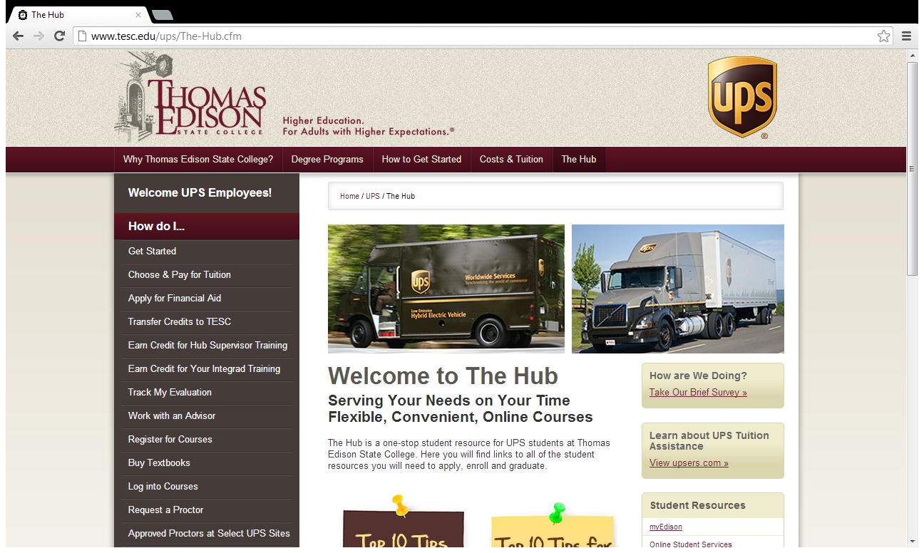
Finished Product

Slide 11
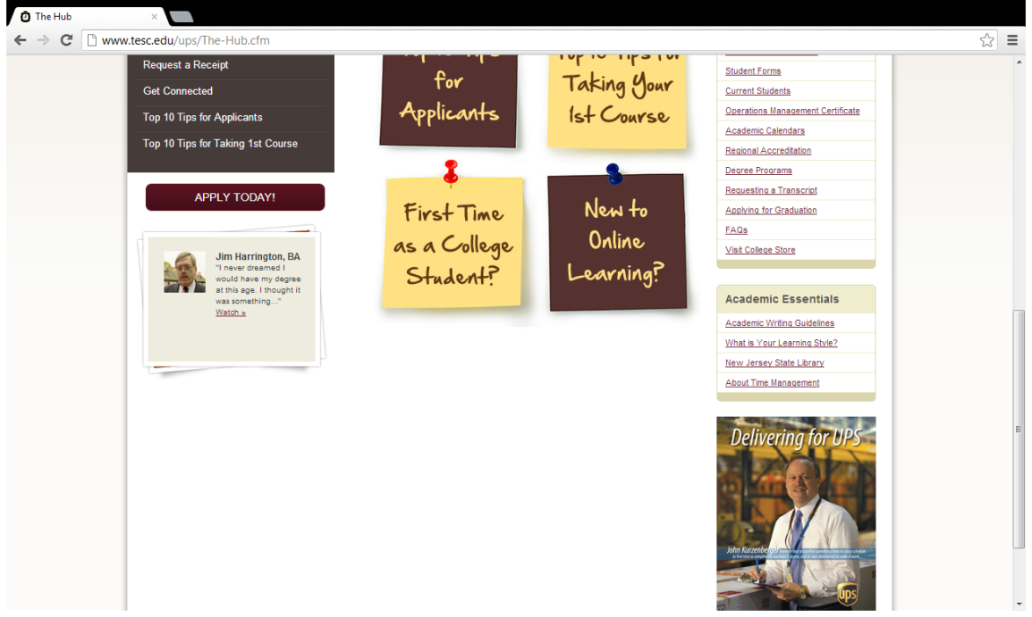
Finished Product

Slide 12

Survey
We are interested in how The Hub webpage meets the needs of our UPS students. We would appreciate your feedback. (All submissions are anonymous.)
How satisfied are you with the information in The Hub webpage?
How satisfied are you with the ease of using The Hub webpage?
Thank you for your participation in this survey. Please include any additional comments in the box below.

Slide 13
Student Responses

Slide 14
Student Responses

Slide 15
Student Responses
Q3. Thank you for your participation in this survey. Please include any additional comments in the box below. (all comments are anonymous)
I think this provides great support for United Parcel Service Management
This is so good for UPS employees. Simple from the application process through graduation. Great job!!

Slide 16

Student Responses
TESC just made things much easier for “UPSers”. I have a lot of the younger work force asking me about TESC. This website will help them register and probably entice more people to get in school.
I only wish this were available when I was
working towards my degree. I recently have applied for graduation.

Slide 17
Google Analytics
1,140 page views of which 818 are unique user views
(July 1- July 31, 2012)
Most visited links:
14% Degree Programs
14% How to Get Started
14% Choose and Pay for Tuition
9.0% Top 10 Tips for Applicants
4.8% Register for Courses
4.7% Request Receipt

Slide 18
Google Analytics
Least visited links:
0.1% Get Connected
0.2% FAQ’s
0.3% Student Forms
0.3% Visit the College Store

Slide 19
What It All Means
Use existing resources to create a value added proposition for students and partners
Vision to implementation to launch within one year
Track, track, track and use results to modify site
Spread the news and engage students for their feedback

